Slide 1
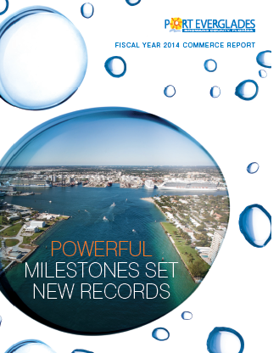
Port Everglades
Port Everglades Annual Commerce Report FY 2014
ANNUAL REPORTS

